Slide 1
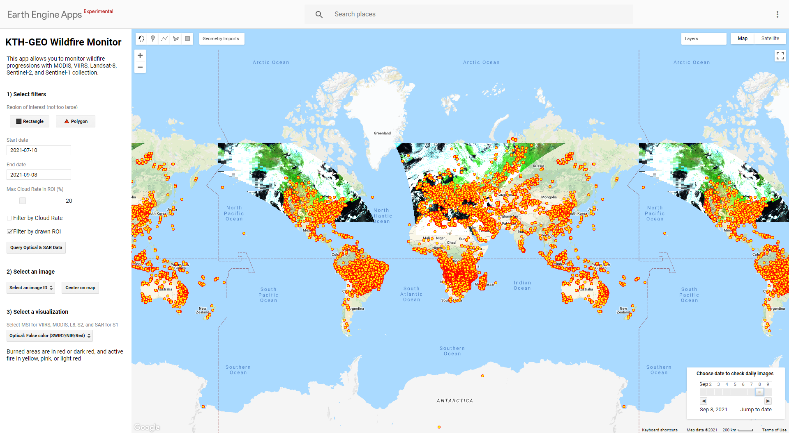
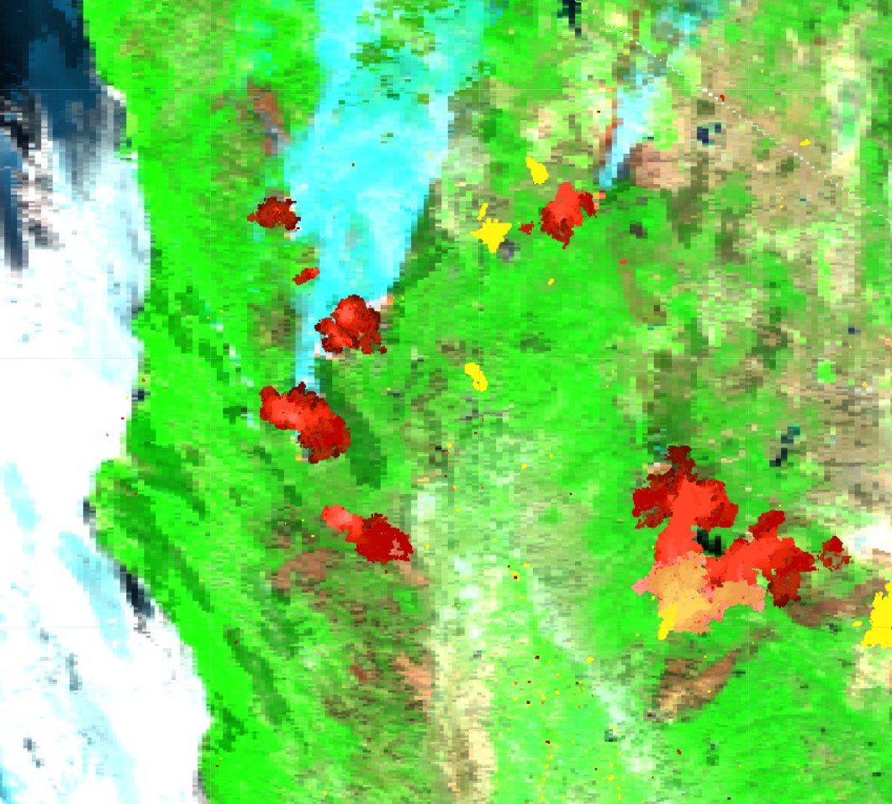
KTH-GEO Wildfire Monitor
Data
Sentinel-1 SAR
Sentinel-2 MSI
MODIS + VIIRS
Active Fire Points
Product
VIIRS Progression 500m
S1S2 Progression 20m

Slide 2
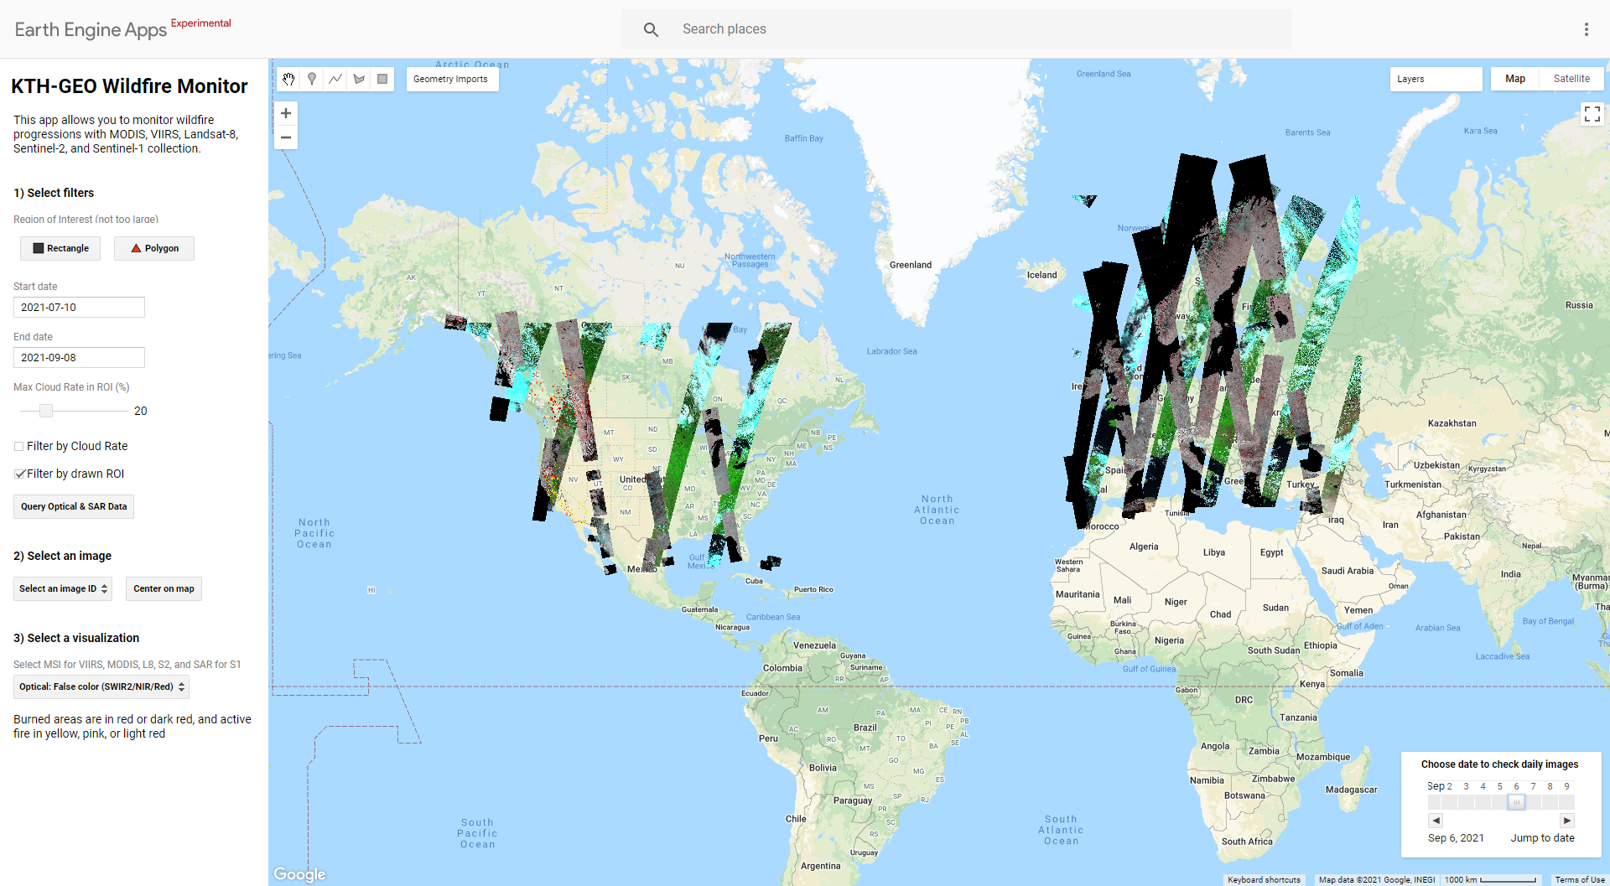
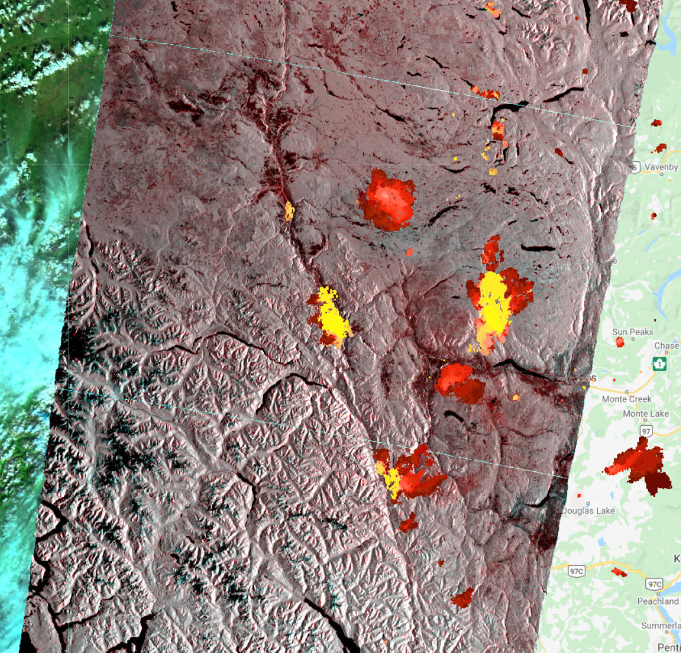
Sentinel-1/2 Near-Real Time Updating

Slide 3
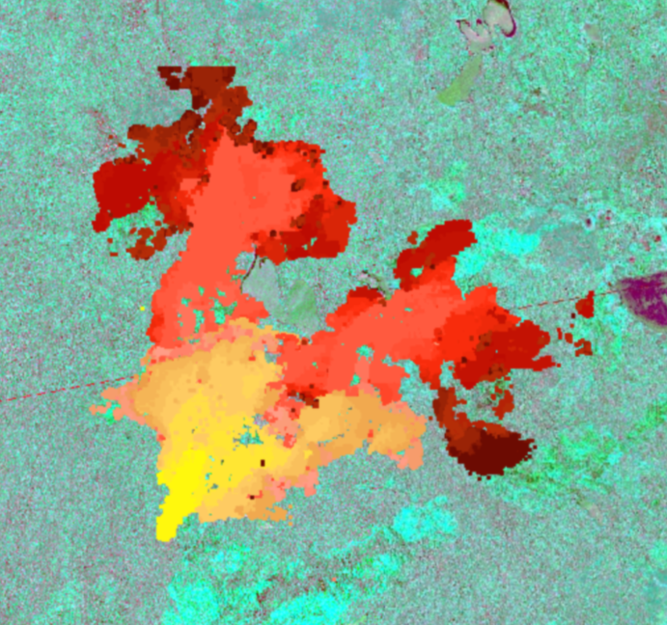
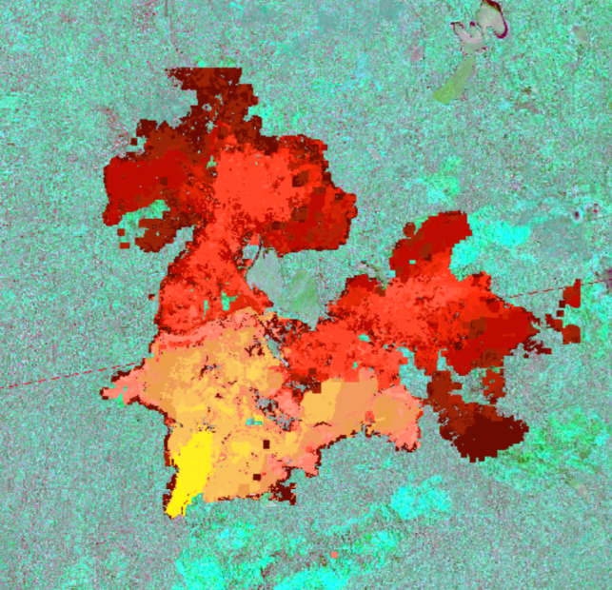
VIIRS Progression 500m
S1S2 Progression 20m

Slide 4





Wildfire-NRT-Auto-Update
Sentinel
Open Hub
VIIRS NRT
Active Fire
S-1/2
Uploaded as ee.ImageCollection
(image properties)
Auto-download
local processing
Upload COG

